Slide 1

Bank loan Case Study Project
- By Daryll Dalmeida

Slide 2
WELCOME!
This is a Bank Loan Case Study
Analysis Project.
This project aims to give an idea of the Exploratory Data Analysis in real business case scenarios. I have also used several techniques inorder to minimize the risk of banks losing their money while lending it to customers.
Link to Project

Slide 3
Problem Statement:
The loan providing companies find it hard to give loans to the people due to their insufficient or non-existent credit history. Because of that, some consumers use it as their advantage by becoming a defaulter.
Here i have used EDA inorder to help the business understand different patterns so that they can ensure that the clients repay the loans on time and do not get rejected.
Tech Stack used : Jupyter Notebook

Slide 4
My approach towards the analysis
At the start, there were alot of null values present in the dataset. So i used Excel inorder to check the null values that were present and found out the columns that needed to be dropped based on the number of nulls i could see in the dataset. I then created a list in the Jupyter notebook which would drop all those columns. I then analyzed the existing columns which had more than 50% null values and removed those too. Some columns had NA values which i then replaced it with the values in a column that had the highest value. I then plotted graphs for Categorical variables to get clear understanding of the distribution of the data. I used boxplots to figure out the columns that had the outliers since the boxplot gave a good idea of the Interquartile range of all those columns and the values lying outside that range. The columns that had outliers were not considered for the analysis because of errors that they could create in the data. I then did the univariate and the bivariate analysis for categorical unordered and categorical ordered variables. I also created different column names for Days Birth,Amt income total,Amt Credit and created different range values for them to understand the type of audience who had taken the loan. Then i also divided the dataset into two target variables : Target 0 and Target 1 and performed the analysis for each of those target variables with respect to the categorical & numeric columns.

Slide 5
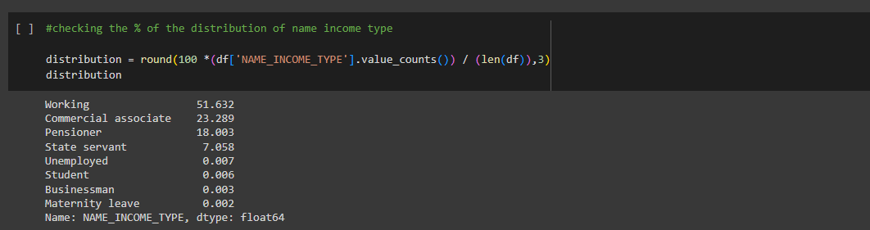
INSIGHTS FROM THE ANALYSIS
1.
So from the above calculations we get the below insights :
The income type belongs to the following class of people :
1. Working people take 51.632%
2. State servants take 7.058%
3. Commercial associate take 23.289%
4. Pensioners take 18.003%
5. Unemployeed, Students , Businessmen & Maternity leave categories account for a mere value of 0.007%,0.006%,0.003%,0.002% respectively.

Slide 6
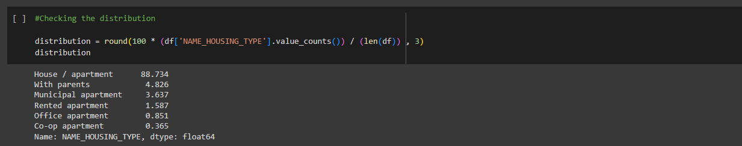
INSIGHTS FROM THE ANALYSIS
1.
From this plot, we get these insights:
1. House / apartment is 88.734%
2. With parents is 4.826%
3. Municipal apartment is 3.637%
4. Rented apartment is 1.587%
5. Office apartment is 0.851%
6. Co-op apartment is 0.365%

Slide 7
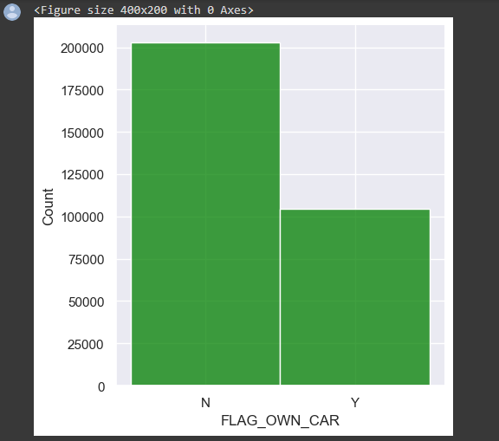

INSIGHTS FROM THE UNIVARIATE ANALYSIS
1.
Majority of the people are from non car holding backgrounds.
1. 65.98% people did not have an own car and applied for loans.
2. 34.011% had their own car.

Slide 8
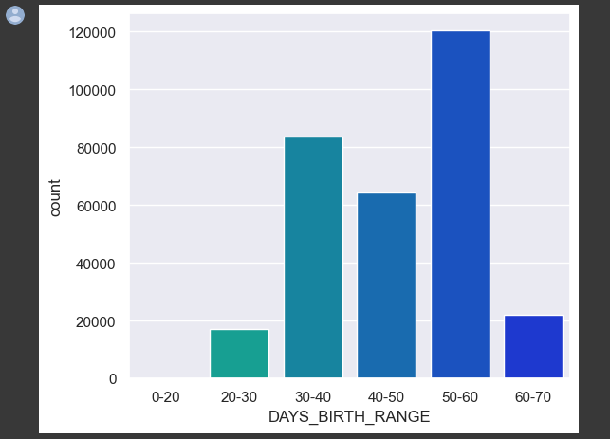
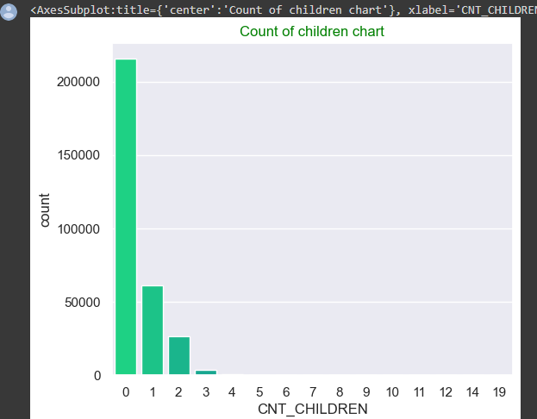
INSIGHTS FROM THE UNIVARIATE ANALYSIS
From the graph, we see that majority of people do not have children and upto 60000 people have
one child whereas less than 50000 have 2
children and very few have more than 2
children.
This graph shows us that people of the age 50-60
had taken the most number of loans with the
age group 30-40 on the 2nd position followed by
age group 40-50 on 3rd.

Slide 9
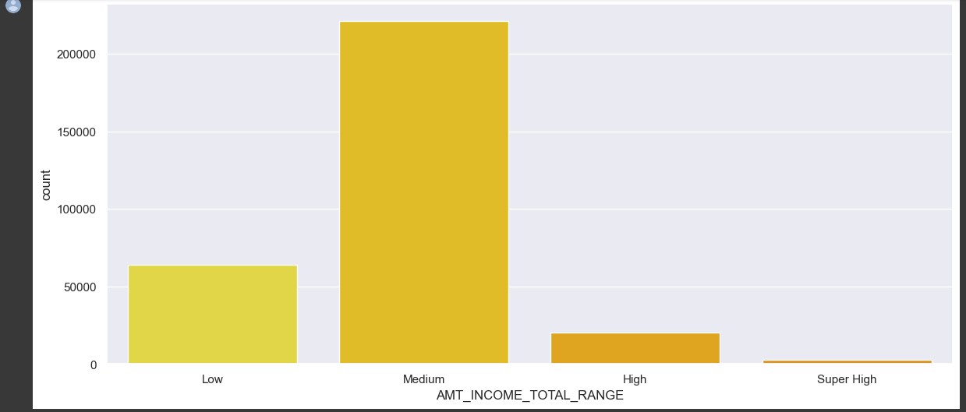
INSIGHTS FROM THE UNIVARIATE ANALYSIS
From the graph :
1. more than 200000 people below to the middle class income type.
2. Just over 50000 people fall into the Low category and the rest take a part of the high and a mere % of people take the super high class.

Slide 10
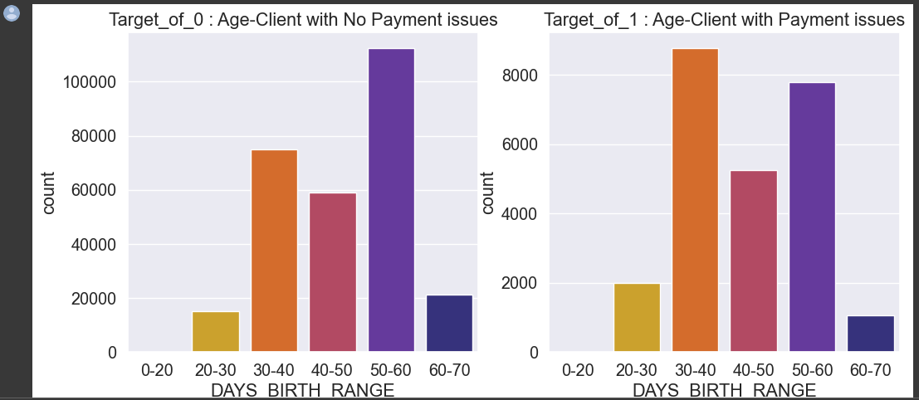
INSIGHTS FROM THE UNIVARIATE ANALYSIS
From the graphs we can figure out that the clients age with no payment issues are the most for age groups 50-60.
Even for the age group 30-40 and 40-50 the number looks high.
Hence , these age groups can be granted loans since they paid them off.

Slide 11
INSIGHTS FROM THE ANALYSIS ON CATEGORICAL VARIABLES
1. Looking at the 1st plot, the majority of people have taken cash loans so that can be the 1st consideration factor.
2. From the 2nd plot , we can see that Females have a better ratio of repaying the loans back than males so banks can take this as the 2nd factor when considering customers for loans.
3. Majority of the clients belong to the working class so they are the ones who pay off most of the loans. Banks should keep in mind not to give loans to Maternity leave females since they have a poor ratio.
4. In the 4th graph, we can see that majority of the people paying off their loans belong to the Secondary and secondary special education background. Also the higher education people can be considered too since they are almost equal to the 1st category. So this is another factor that shows that these groups of people can be granted loans.
5. From the 5th graph, we come to know that the major age group of clients repaying their loans off were from 50-60. Hence, we can consider that group along with age group 30-40 to be granted loans. Also, married people are the ones to take the most loans and repay them on time hence they should be kept in mind while granting loans.
6. People living in house/apartments tend to pay the loans on time whereas Co-op apartment clients least pay their loans on time. This should be kept in mind too.
7. For occupation type, the laborers have the highest amount of loans paid off on time. The HR staff professionals are the ones who least paid them on time. Hence, HR staff should not be considered.
8. People having 0 children have the highest success paying the loans followed by 1 and 2. Hence, people having 0,1 or 2 children should be given loans.
9. For Amount credit range and amount income range, people with High Credit range and medium income range were observed
to pay the loans on time. Hence, they should be granted loans
Link to the working file

Slide 12
INSIGHTS FROM THE BIVARIATE ANALYSIS
The Bivariate Analysis was performed on the Target = 0 and Target = 1 variables. The following variables were used for the analysis :
1. AMT GOODS PRICE VS AMT ANNUITY
2. AMT INCOME TOTAL VS AMT CREDIT
3. AMT GOODS PRICE VS AMT CREDIT
Insights :
1. People who have completed their higher education from married category and secondary education tend to have greater amount of credits than any other group.
2. Higher education customers have the most outliers than any other group
3. Widows from the academic degree tend to have a lower credit amount as compared to other family types.
4. Higher education customers tend to have a good credit amount than the other education type categories
Link to the working file

Slide 13
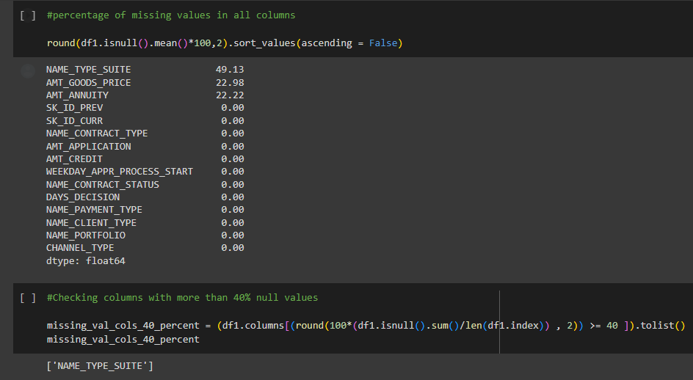
ANALYSIS ON THE PREVIOUS APPLICATION DATA
Here, i have found out the percentage of the missing values that were more than 40% and removed those columns. Here we had only one column that had greater than 40% missing data.
Link to the working file

Slide 14
UNIVARIATE ANALYSIS ON THE PREVIOUS APPLICATION DATA
As we can see from the working file :
1. Majority of the people granted loans were from the Consumer loans followed by the Cash loans.
2. From the second graph, we understand that the best Channel Type to get the loan approved were from Countrywide followed by Credit and Cash offices. Credit and Cash offices also had the highest rejection rates.
3. Majority of the people who got their Loans approved selected Cash from Bank payment as the mode of payment
Link to the working file

Slide 15
OVERALL PROJECT INSIGHTS
1. The majority of people have taken cash loans so that can be the 1st consideration factor while a bank grants loan to customers.
2. Females have a better ratio of repaying the loans back than males so banks can take this as the 2nd factor when considering customers for loans.
3. Majority of the clients belong to the working class so they are the ones who pay off most of the loans.
4. Banks should keep in mind not to give loans to Maternity leave females since they have a poor ratio.
5. Majority of the people paying off their loans belong to the Secondary and secondary special education background. Also the higher education people can be considered too since they are almost equal to the 1st category. So this is another factor that shows that these groups of people can be granted loans.
6. Major age group of clients repaying their loans off were from 50-60. Hence, we can consider that group along with age group 30-40 to be granted loans.
7. Married people are the ones to take the most loans and repay them on time hence they should be kept in mind while granting loans.
8. People living in house/apartments tend to pay the loans on time whereas Co-op apartment clients least pay their loans on time. This should be kept in mind too.
9. For occupation type, the laborers have the highest amount of loans paid off on time. The HR staff professionals are the ones who least paid them on time. Hence, HR staff should not be considered.
10. People having 0 children have the highest success paying the loans followed by 1 and 2. Hence, people having 0,1 or 2 children should be given loans.
11. For Amount credit range and amount income range, people with High Credit range and medium income range were observed to pay the loans on time. Hence, they should be granted loans
12. From previous application data, majority of people were from Consumer loan category hence they should be the 1st point of consideration.
13. Most people paid the amount back by Cash hence they should be given a consideration factor.
14. The Best channel type for loan approvaals are from Countrywide and Credit/Cash offices.
Link to the working file

Slide 16
THANK YOU

